Slide 1
Teradata is a Relational Database Management System (RDBMS):
Designed to run the world’s largest commercial databases.
Preferred solution for enterprise data warehousing (OLAP).
Executes on UNIX-MP-RAS or NT-based system platforms
Compliant with ANSI industry standards
Runs on single (SMP) or multiple (MPP) nodes
Acts as “Database server” to client applications throughout the enterprise
Uses Parallelism to manage Terabytes of data
“Shared-Nothing Architecture”

Slide 2
Advantage Teradata
Unlimited, Proven Scalability
Unlimited Parallelism - Parallel sorts/aggregations, temporary tables –
“Shared-Nothing” architecture
Mature Optimizer - Complex queries, joins per query, ad-hoc processing
It’s a “Cost Based Optimizer”.
Model the Business - 3NF, robust view processing, star schema
Lowest TCO - ease of setup & maintenance, robust parallel utilities, no re-orgs, lowest disk to data ratio, robust expansion utility
High Availability - No single point of failure, scalable data loading, parallel load utilities

Slide 3
Advantage Teradata
Enormous capacity
Billions of rows
Terabytes of data
High-performance parallel processing
Single database server for multiple clients “Single Version of the Truth”
Network and Mainframe connectivity
Industry standard access language (SQL)
Manageable growth via modularity
Fault tolerance at all levels of hardware and software
Data integrity and reliability

Slide 4
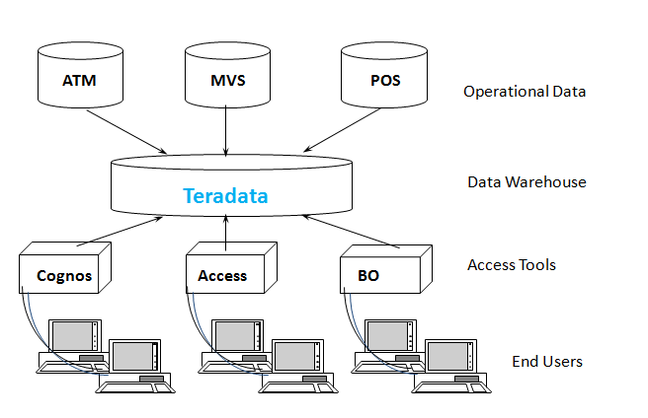
Advantage Teradata Warehouse

Slide 5
History of Teradata
Following is a quick summary of the history of Teradata, listing major milestones.
1979 – Teradata was incorporated
1984 – Release of first database computer DBC/1012
1986 – Fortune magazine names Teradata as ‘Product of the Year’
1999 – Largest database in the world using Teradata with 130 Terabytes
2002 – Teradata V2R5 released with Partition Primary Index and compression
2006 – Launch of Teradata Master Data Management solution
2008 – Teradata 13.0 released with Active Data Warehousing
2011 – Acquires Teradata Aster and enters into Advanced Analytics Space
2012 – Teradata 14.0 introduced
2014 – Teradata 15.0 introduced

Slide 6
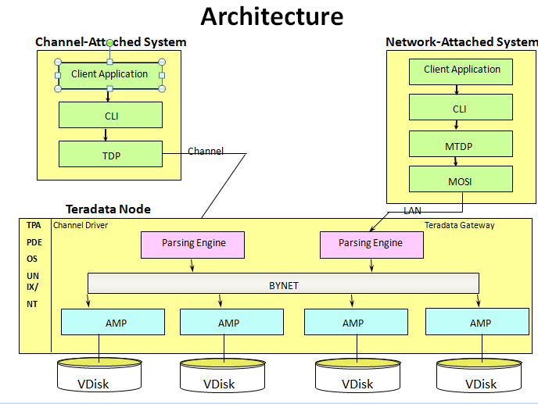

Slide 7
Understanding Node
Parsing Engine
BYNET
AMP
AMP
AMP
AMP
Vdisk
Vdisk
Vdisk
Vdisk

Slide 8
Node Components
Component | Functionality
Parsing Engine | Managing individual sessions (up to 120) Parsing and optimizing your SQL requests Dispatching the optimized plan to the AMPs ASCII / EBCDIC conversion (if necessary) Sending the answer set response back to the requesting client
AMP | Storing and retrieving rows to and from the disks Lock management Sorting rows and Aggregating columns Join processing Output conversion and formatting Creating answer sets for clients Disk space management and Accounting Special utility protocols Recovery processing
Vdisk | A vdisk (pronounced, "VEE-disk") is the logical disk space that is managed by an AMP.

Slide 9
Teradata relies on three architectural components that have set the rules for parallel processing.
PE or the Optimizer(Parse Engine
The PE is the boss and tells the AMPs exactly what to do.
When a user logon to Teradata their logon is accepted or rejected by a Parsing Engine
The Parsing Engine will accept each query from that user and come up with a plan for the AMPs to satisfy the request.
The PE‘s plan is passed to the AMPs via the BYNET
The AMPs will retrieve the data requested from their virtual disks and pass it back up the BYNET to the PE.
The PE will then deliver the data to the user
The Parsing Engines having the capability to handle up to 120 users at a time

Slide 10
The AMPs
The PE passes the PLAN to the AMPs over the BYNET. The AMPs then retrieve the rows they own from their disks and pass it back to the PE over the BYNET
The AMPs organize every table in separate blocks just like you might organize your clothes in separate dresser drawers
When a table is first created each AMP creates a table header on their disk
When the table is loaded each AMP receives rows for that table that they and only they own.

Slide 11
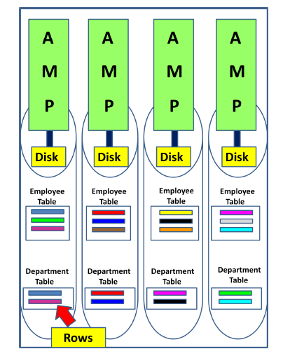

Slide 12
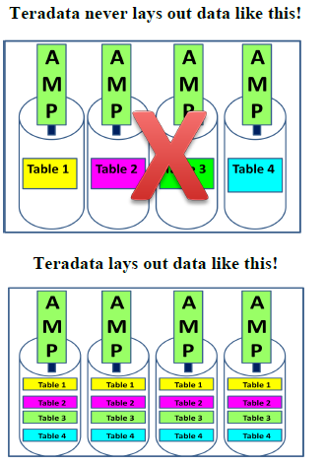

Slide 13
The BYNET
The BYNET gets its name from the Banyan tree. The Banyan tree has the ability to continually plant new roots to grow forever
The BYNET is the communication network between AMPs and PE‘s.
The AMPs then retrieve the data requested by the PE and they deliver their portion of the answer set to the PE over the BYNET.
There are always two BYNETs for redundancy and extra bandwidth.

Slide 14
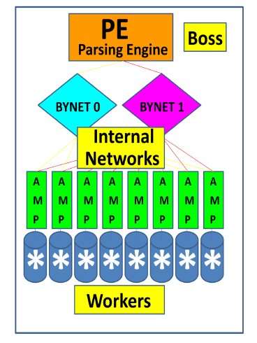

Slide 15
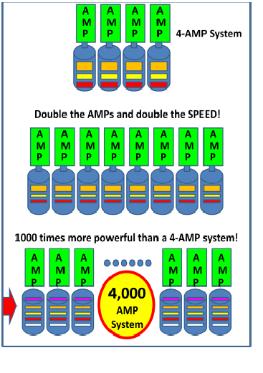

Slide 16
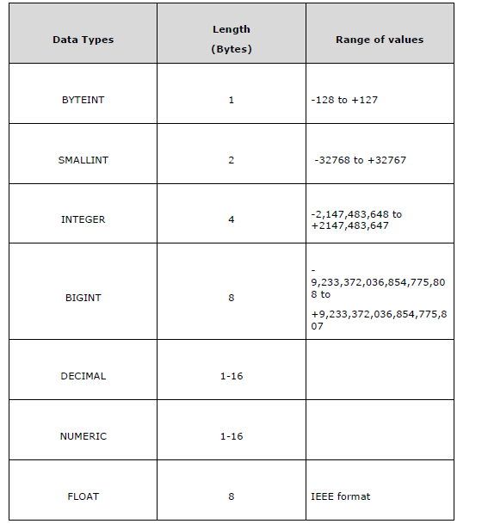
Teradata Data types

Slide 17
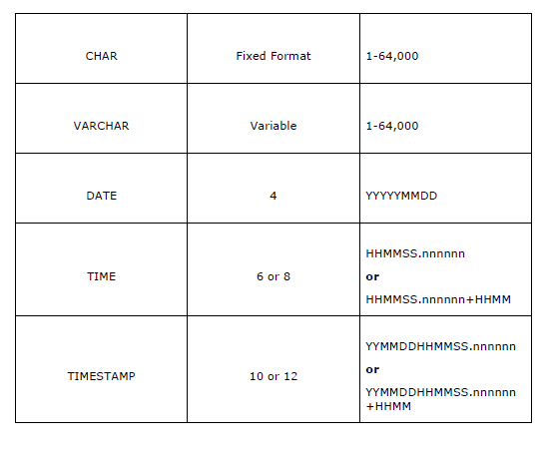

Slide 18
Determining the Release of Your Teradata System:
SELECT * FROM DBC.DBCINFO;
InfoKey InfoData
RELEASE V2R.05.01.03.00
VERSION 05.01.03.00
Teradata Table
Tables in Relational model are defined as collection of data. They are represented as rows
and columns.
Table Types
Permanent Table: This is the default table and it contains data inserted by the
user and stores the data permanently.

Slide 19
Create Table
CREATE TABLE command is used to create tables in Teradata.
Following is the generic syntax of CREATE TABLE statement.
CREATE <SET/MULTISET> TABLE <Tablename>
< Table Options>
<Column Definitions>
<Index Definitions>;
Table Options – Specifies the physical attributes of the table such as Journal and
Fallback.
Column Definition – Specifies the list of columns, data types and their attributes.
Index Definition – Additional indexing options such as Primary Index, Secondary
Index and Partitioned Primary Index.

Slide 20
FALLBACK
Specifies whether to create and store a duplicate copy of each table created in the new user.
Before Journal keeps the images of the table before making the change to the table. Very useful, if the changes need to be reverted incase of a fault or rollback.
After Journal keeps the images of the table after the changes has been made to the table.

Slide 21
CREATE TABLE EMPLOYEE
(
EmployeeNo INTEGER,
FirstName VARCHAR(30) ,
LastName VARCHAR(30) ,
DeptNo BYTEINT
)
SHOW TABLE command to view the Definition of the table.
SHOW TABLE Employee;
INSERT INTO EMPLOYEES VALUES (1,’BABJEE’,’REDDY’,10)

Slide 22
Set Versus Multiset
Teradata classifies the tables as SET or MULTISET tables based on how the duplicate
records are handled. A table defined as SET table doesn’t store the duplicate records,
whereas the MULTISET table can store duplicate records.
CREATE SET TABLE EMPLOYEE_SET
(
EmployeeNo INTEGER,
FirstName VARCHAR(30) ,
LastName VARCHAR(30) ,
DeptNo BYTEINT
)
INSERT INTO EMPLOYEES_SET VALUES (1,’BABJEE’,’REDDY’,10)

Slide 23
Multiset table
CREATE MULTISET TABLE EMPLOYEE_MULTISET
(
EmployeeNo INTEGER,
FirstName VARCHAR(30) ,
LastName VARCHAR(30) ,
DeptNo BYTEINT
)
Volatile Table:
The data inserted into a volatile table is retained only during the
user session. The table and data is dropped at the end of the session. These tables
are mainly used to hold the intermediate data during data transformation.

Slide 24
CREATE VOLATILE TABLE dept
(
dept_no INTEGER,
avg_salary INTEGER,
max_salary INTEGER,
min_salary INTEGER
) on commit preserve rows;
INSERT INTO DEPT VALUES(1,10000,1000000,20000)

Slide 25
Global Temporary Table
The definition of Global Temporary table is stored in data dictionary and they can be used by many users/sessions.
But the data loaded into global temporary table is retained only during the session.
CREATE SET GLOBAL TEMPORARY TABLE dept_GTB
(
dept_no INTEGER,
avg_salary INTEGER,
max_salary INTEGER,
min_salary INTEGER
) on commit preserve rows;
List of table in database
Select tablename form dbc.tables where tablekind=‘T’

Slide 26
CREATE SET TABLE EMP
(
EmployeeNo INTEGER,
FirstName VARCHAR(30) ,
LastName VARCHAR(30) ,
DOB DATE FORMAT 'YYYY-MM-DD',
DepartmentNo BYTEINT
)
INSERT INTO EMP VALUES(200,’BABJEE’,’REDDY’,’2001-10-2016’,20)
CREATE TABLE DEPT_DEFAULT
( Dept INTEGER DEFAULT 10
,Dept_name CHAR(20) DEFAULT 'Sales'
,Mgr_Emp# INTEGER
)

Slide 27
ALTER TABLE COMMAND
ALTER TABLE emp
ADD BirthDate DATE FORMAT 'YYYY-MM-DD',
DROP DOB;
DROP TABLE COMMAND
DROP TABLE EMP
SHOW TABLE EMP

Slide 28
CRATE TABLE STUDENTS (STUDENT_ID INTEGER,LAST_NAME VARCHAR(40),FIRST_NAME VARCHAR(40),CLASS_CODE
VARCHAR(2),GRADE_PT FLOAT)
INSERT INTO STUDENTS VALUES(123250, 'Phillips' ,'Martin' 'SR' 3.00)
INSERT INTO STUDENTS VALUES(125634, 'Hanson', 'Henry', 'FR' 2.88)
INSERT INTO STUDENTS VALUES(234121 , 'Thomas', 'Wendy', 'FR' 4.00)
INSERT INTO STUDENTS VALUES(231222, 'Wilson', 'Susie' ,'SO', 3.80)
INSERT INTO STUDENTS VALUES(260000, 'Johnson', 'Stanley',NULL,NULL,NULL)
INSERT INTO STUDENTS VALUES(280023, 'McRoberts', 'Richard', 'JR', 1.90)
INSERT INTO STUDENTS VALUES(322133, 'Bond', 'Jimmy', 'JR' 3.95)
INSERT INTO STUDENTS VALUES(324652, 'Delaney', 'Danny', 'SR', 3.35)
INSERT INTO STUDENTS VALUES(333450, 'Smith', 'Andy','SO' 2.00)
INSERT INTO STUDENTS VALUES(423400, 'Larkins' 'Michael', 'FR', 0.00)

Slide 29
SELECTING REQUIRED COLUMS
SELECT First_name
,Last_name
,Class_Code
,Grade_Pt
FROM Student_Table ;
WHERE Clause
By adding a WHERE clause to the SELECT, a constraint is established to potentially limit which rows are returned based on a TRUE comparison to specific criteria or set of conditions.
The following SELECT can be used to return the students with a B (3.0) average or better from the Student table:
SELECT Student_ID
,Last_Name
,Grade_Pt
FROM Student_Table
WHERE Grade_Pt >= 3.0 ;

Slide 30
Compound Comparisons (AND / OR)
SELECT Last_Name
,First_Name
FROM Student_Table
WHERE Grade_Pt = 3.0 AND Grade_Pt = 4.0;
SELECT Student_ID
,Last_Name
,First_Name
,Grade_Pt
FROM Student_Table
WHERE Grade_Pt = 3.0 OR Grade_Pt = 4.0 ;
SELECT *
FROM Student_Table
WHERE Grade_Pt = 3.0 OR Grade_Pt = 4.0 AND Class_Code = 'FR' ;

Slide 31
SELECT Last_Name
,Class_Code
,Grade_Pt
FROM Student_Table
WHERE (Grade_Pt = 3.0 OR Grade_Pt = 4.0) AND Class_Code = 'FR' ;
SELECT *
FROM Student_Table
WHERE Grade_Pt = NULL AND Class_Code = NULL ;
SELECT *
FROM Student_Table
WHERE Grade_Pt = NULL AND Class_Code = IS NULL ;

Slide 32
Using NOT in SQL Comparisons
SELECT Last_Name
,First_Name
,Class_Code
,Grade_Pt
FROM Student_Table
WHERE NOT (Grade_Pt >= 3.0 AND Class_Code <> 'SR') ;
SELECT Last_Name, First_Name
,Class_Code
,Grade_Pt
FROM Student_Table
WHERE NOT (Grade_Pt >= 3.0 AND Grade_Pt IS NOT NULL AND
Class_Code <> 'SR' AND Class_Code IS NOT NULL) ;

Slide 33
USING I N OPERATOR
SELECT Last_Name
,Class_Code
,Grade_Pt
FROM Student_Table
WHERE Grade_Pt IN (2.0, 3.0, 4.0) ;
USING NOT IN OPERATOR
SELECT Last_Name
,Class_Code
,Grade_Pt
FROM Student_Table
WHERE Grade_Pt NOTIN (2.0, 3.0, 4.0) ;

Slide 34
Using Quantifiers Versus IN
SELECT Last_Name
,Class_Code
,Grade_Pt
FROM Student_Table
WHERE Grade_Pt = ANY (2.0, 3.0, 4.0) ;
SELECT Last_Name
,Grade_Pt
FROM Student_Table
WHERE Grade_Pt NOT = ALL (2.0, 3.0, 4.0) ;
USING BETWEEN
SELECT Grade_Pt
FROM Student_Table
WHERE Grade_Pt BETWEEN 2.0 and 4.0 ;

Slide 35
Character String Search (LIKE)
SELECT *
FROM Student_Table
WHERE Last_Name LIKE 'sm%' ;
SELECT *
FROM Student_Table
WHERE Last_Name LIKE ('_a%') ;
SELECT *
FROM Student_Table
WHERE Last_Name LIKE ALL ('%S%', '%m%') ;
SELECT *
FROM Student_Table
WHERE Last_Name LIKE ALL ('%S%', '%m%') ;

Slide 36
Derived Columns
SELECT 2+4*5, (2+4)*5
,2+4/5, (2+4)/5
,2+4.0/5, (2+4.0)/5
,10**9 ;
SELECT salary (format 'ZZZ,ZZ9.99')
,salary/12 (format 'Z,ZZ9.99')
FROM Pay_Table ;
SELECT salary (format 'ZZZ,ZZ9.99')
,salary/12 (format 'Z,ZZ9.99')
FROM Pay_Table
WHERE salary/12 > 1000 ;
SELECT salary AS Annual_salary
,salary/12 AS Monthly_salary
FROM Pay_Table ;

Slide 37
SELECT 200/100 AS Div200
,204 MOD 100 AS Last2
,2 MOD 2 AS Even
,3 MOD 2 AS Odd
,ABS(1) AS WasPositive
,ABS(-1) AS PositiveNow
,SQRT(4) AS SqRoot ;
Breaking Conventions
SELECT salary "Annual salary"
,salary/12 "Monthly salary"
FROM Pay_Table
ORDER BY "Annual Salary" ;

Slide 38
ORDER BY
SELECT *
FROM Student_Table
WHERE Grade_Pt > 3
ORDER BY Grade_Pt ;
SELECT *
FROM Student_Table
WHERE Grade_Pt > 3
ORDER BY Grade_Pt DESC;
SELECT *
FROM Student_Table
WHERE Grade_Pt > 3
ORDER BY 5 DESC ;
SELECT Last_Name
,Class_Code
,Grade_Pt
FROM Student_Table
ORDER BY 2 DESC, 1 ;

Slide 39
TOP Rows Option
SELECT TOP 3 Last_Name
,Class_Code, Grade_Pt
FROM Student_Table
ORDER BY 2 DESC, 1 ;
DISTINCT
SELECT DISTINCT Class_code
FROM student_table
ORDER BY class_code;
SELECT DISTINCT class_code, grade_pt
FROM student_table
ORDER BY class_code, grade_pt;

Slide 40
HELP commands
HELP DATABASE My_DB ;
HELP USER My_User;
HELP TABLE My_Table ;
HELP VIEW My_View ;
HELP SESSION;

Slide 41
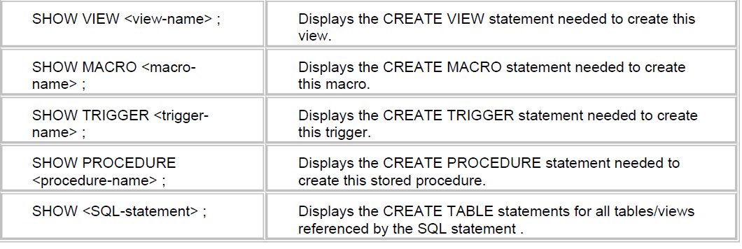
SHOW COMMAND
SHOW TABLE <TABLE-NAME> Displays the create table statement need to create table
SHOW TABLE Employee ;

Slide 42
EXPLAIN
The EXPLAIN command is a powerful tool provided with the Teradata database. It is designed to provide an English explanation of what steps the AMP must complete to satisfy the SQL request. The EXPLAIN is based on the PE's execution plan.
EXPLAIN
SELECT * FROM Student_table ;
Adding Comments
-- the double dash at the start of a single line denotes a comment is on that line
/* the slash asterisk at the start of a line denotes the beginning of a comment
*/ the asterisk slash (reversed from the start of a comment) is used to end a comment.

Slide 43
ACCOUNT Function
A user within the Teradata database has an account number. This number is used to identify the user, provide a basis for charge back, if desired and establish a basic priority.
SEL[ECT] ACCOUNT ;
SELECT SESSION;
SELECT DATABASE;

Slide 44
Data Conversions
CAST
Data can be converted from one type to another by using the CAST function.
CAST ( <smallint-data> AS CHAR(5) ) /* smallint to character */
CAST ( <decimal-data> AS INTEGER ) /* truncates decimals */
CAST ( <byteint-data> AS SMALLINT ) /* binary to smallint */
CAST ( <char-data> AS BYTE (128) ) /* character to binary */
CAST ( <byteint-data> AS VARCHAR(5) ) /* byteint to character */
CAST ( <integer-data> AS FLOAT) /* integer to float point */
SELECT CAST('ABCDE' AS CHAR(1) ) AS Trunc
,CAST(128 AS CHAR(3) ) AS OK
,CAST(127 AS INTEGER) AS Bigger
,CAST(121.53 AS SMALLINT) AS Whole
,CAST(121.53 AS DECIMAL(3,0)) AS Rounder ;

Slide 45
FORMAT
SELECT 'ABCDE' (FORMAT 'XXX') AS Shorter
,121.53 (FORMAT '99999') AS Fmt_121
,121.53
,991001(date) (FORMAT 'MM/dd/Yy') AS Fmt_NumDate
,991001(date) (FORMAT 'mmmbdd,byyyy') AS Fmt_Date ;
LOWER Function
SELECT LOWER ('ABCDE') AS Result ;
UPPER Function
SELECT UPPER('aBcDe') AS Result ;

Slide 46
Aggregation
SELECT SUM(Grade_pt)
,AVG(Grade_pt)
,MIN(Grade_pt)
,MAX(Grade_pt)
,COUNT(Grade_pt)
FROM Student_table;
SELECT SUM(Grade_Pt) AS "Total"
,AVG(Grade_Pt) AS "Average"
,MIN(Grade_Pt) AS Smallest
,MAX(Grade_Pt) AS Highest
,COUNT(Grade_Pt) AS "Count"
FROM Student_table ;

Slide 47
SELECT SUM(salary) (Title 'Salary Total', Format '$$$$,$$9.99')
,SUM(salary*1.05) (Title '+5% Raise', Format '$$$$,$$9.99')
,SUM(salary*1.10) (Title '+10% Raise', format '$$$$,$$9.99')
,AVG(salary) (Title 'Average Salary', format '$$$$,$$9.99'),
,SUM(salary) / COUNT(salary) (Title 'Computed Average Salary')
( format '$$$$,$$9.99')
SELECT SUM(Grade_Pt) AS "Total"
,AVG(Grade_Pt) AS "Average"
,MIN(Grade_Pt) AS Smallest
,MAX(Grade_Pt) AS Highest
,COUNT(Grade_Pt) AS "Count"
FROM Student_table
WHERE class_code = 'SR' ;

Slide 48
SELECT Class_code
,SUM(Grade_Pt) AS "Total"
,AVG(Grade_Pt) AS "Average"
,MIN(Grade_Pt) AS Smallest
,MAX(Grade_Pt) AS Highest
,COUNT(Grade_Pt) AS "Count"
FROM Student_table
GROUP BY Class_code ;
SELECT Last_name
,Class_code
,SUM(Grade_Pt) AS "Total"
,AVG(Grade_Pt) AS "Average"
,MIN(Grade_Pt) AS Smallest
,MAX(Grade_Pt) AS Highest
,COUNT(Grade_Pt) AS "Count"
FROM Student_table
GROUP BY 1, 2 ;

Slide 49
SELECT Class_code
,SUM(Grade_Pt) AS "Total"
,AVG(Grade_Pt) AS "Average"
,MIN(Grade_Pt) AS Smallest
,MAX(Grade_Pt) AS Highest
,COUNT(*) AS "Count"
FROM Student_table
GROUP BY 1
ORDER BY 1 ;
SELECT Class_code
,SUM(Grade_Pt) AS "Total"
,AVG(Grade_Pt) AS "Average"
,COUNT(Grade_Pt) AS "Count"
FROM Student_table
HAVING "Average" > 3.00
GROUP BY 1
ORDER BY 1;

Slide 50
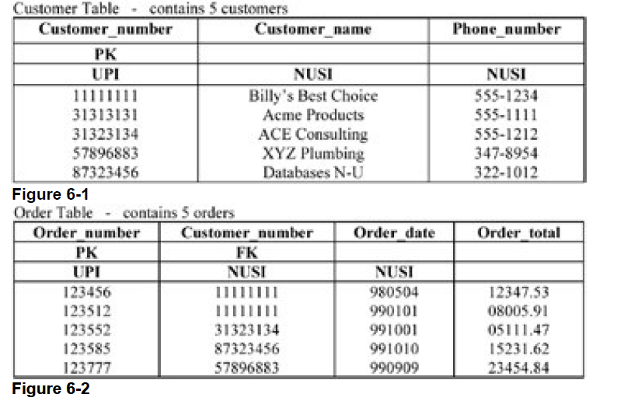
Subquery
The subquery is a commonly used technique and powerful way to select rows from one table based on
values in another table

Slide 51
find all customers that have an order of more than $10,000.00
SELECT Customer_name
,Phone_number
FROM Customer_Table
WHERE Customer_number IN ( SELECT Customer_number
FROM Order_table WHERE Order_total > 10000 ) ;
find all the orders by a specific customer:
SELECT Order_number
,Order_total
FROM Order_Table
WHERE Customer_number IN ( SELECT Customer_number
FROM Customer_table WHERE Customer_name LIKE ‘RAM%');

Slide 52
subquery to match two columns with two values in the subquery to find the highest dollar orders for each customer:
SELECT Customer_number AS Customer
,Order_number
,Order_total
FROM Order_table
WHERE (customer_number, order_total) IN
(SELECT customer_number, MAX(order_total) FROM order_table
GROUP BY 1) ;

Slide 53
find the customer who has ordered the single highest dollar amount order.
SELECT Customer_name
,Phone_number
FROM Customer_Table
WHERE customer_number IN
(SELECT customer_number FROM Order_Table
WHERE Order_total IN
(SELECT MAX(Order_total) FROM Order_Table) ) ;
find the customers without an order
SELECT Customer_name
,Phone_number
FROM Customer_Table
WHERE Customer_number NOT IN
( SELECT Customer_number FROM Order_table) ;

Slide 54
ANY
SELECT Customer_name
,Phone_number
FROM Customer_Table
WHERE customer_number = ANY
(SELECT customer_number FROM Order_Table
WHERE Order_total >
( SELECT AVG(Order_total) FROM Order_Table ) );

Slide 55
Correlated Subquery Processing
It is an excellent technique to use when there is a need to determine which rows to SELECT based on one or more values from another table
List employees max salary for each Dept
SELECT Last_name
,First_name
,Dept_no
,Salary
FROM Employee_Table AS emp
WHERE Salary =
( SELECT MAX(Salary) FROM Employee_table AS emt
WHERE emp.Dept_no = emt.Dept_no )
ORDER BY 3,1 ;

Slide 56
Correlated subquery uses the AVG function to find all employees who earn less than the average pay in their department
SELECT Last_name
,First_name
,Dept_no
,Salary ( format '$$$$,$$9.99' )
FROM Employee_Table AS emp
WHERE Salary <= ( SELECT AVG(Salary) FROM Employee_table AS e
WHERE emp.Dept_no = e.Dept_no )
ORDER BY 3,1 ;

Slide 57
Exist and Not Exist
SELECT Customer_name
FROM Customer_table AS CUST
WHERE EXISTS ( SELECT * FROM Order_table AS OT
WHERE CUST.Customer_number = OT.Customer_number ) ;
SELECT Customer_name
FROM Customer_table AS CUST
WHERE NOT EXISTS ( SELECT * FROM Order_table AS OT
WHERE CUST.Customer_number = OT.Customer_number ) ;

Slide 58
Join Processing
SELECT cust.Customer_number
,Customer_name
,Order_number
,Order_total (FORMAT '$$$,$$9.99' )
FROM Customer_table AS cust
,Order_table AS ord
WHERE cust.customer_number = ord.customer_number
ORDER BY 2 ;
Product Join
next join example uses a WHERE clause, but it only limits which rows participate in the join and does not provide a join condition
SELECT Customer_name,Order_number
,Order_total (FORMAT '$$$,$$9.99' )
FROM Customer_table AS cust
,Order_table AS ord
WHERE customer_name = 'Billy" Best Choice';

Slide 59
Date Processing
Select date
SELECT Order_date
,Order_date +60 AS Due_Date
,Order_total ,Due_date -10 (Title 'Discount Date')
,Order_total*.98 (FORMAT '$$$$,$$$.99', Title 'Discounted')
FROM Order_table
WHERE Order_date > 981231 ;
SELECT Order_date
,Order_date +365 (Title 'Year Later Date')
,Order_total (FORMAT '$$$$,$$$.99')
FROM Order_table

Slide 60
SELECT ADD_MONTHS(Order_date, 2) (Title 'Due Date')
,Order_date (FORMAT 'YYYY-MM-DD')
,Order_total (FORMAT '$$$$,$$$.99')
FROM Order_table
ORDER BY 2 ;
SELECT EXTRACT(YEAR FROM '2000-10-01') AS Yr_Part
,EXTRACT(MONTH FROM '2000-10-01') AS Mth_Part
,EXTRACT(DAY FROM '2000-10-01') AS Day_Part
,EXTRACT(HOUR FROM '10:01:30') AS Hr_Part
,EXTRACT(MINUTE FROM '10:01:30') AS Min_Part
,EXTRACT(SECOND FROM '10:01:30') AS Sec_Part ;

Slide 61
SELECT EXTRACT(Month FROM Order_date)
,COUNT(*) AS Nbr_of_rows
,AVG(Order_total) FROM Order_table GROUP BY 1 ORDER BY 1 ;
sel * from sys_calendar.calendar where calendar_date=1011001 ;
SELECT Order_date
,Order_total ,Quarter_of_Year
,Week_of_Month
FROM Order_table INNER JOIN Sys_Calendar.Calendar
ON Order_date = calendar_date
WHERE Quarter_of_Year = 3
AND Week_of_Month < 2;

Slide 62
SELECT Order_date
,Order_total (FORMAT '$$$$,$$$.99')
,Day_of_Week
,Wkday_Day
FROM Order_table INNER JOIN Sys_Calendar.Calendar
ON order_date = calendar_date
INNER JOIN Week_Days
ON Day_of_Week = Wkday_no
WHERE Quarter_of_Year = 3
AND Week_of_Month < 2

Slide 63
SELECT ,CHARACTERS(First_name) AS C_length
FROM Employee_table WHERE CHARACTERS(First_name) < 7 ;
SELECT Last_name ,CHAR(Last_name) AS C_length
FROM Employee_table WHERE CHARACTERS(First_name) < 7
SELECT First_name ,CHARACTER_LENGTH(First_name) AS C_length FROM Employee_table
WHERE CHARACTER_LENGTH(First_name) < 7 ;
SELECT SUBSTRING('Partners' FROM 2 FOR 3) AS F2F3
, SUBSTRING('Partners' FROM 2) AS F2ALL
, SUBSTRING('Partners' FROM -1 FOR 6) AS BeforeF6
, SUBSTRING('Partners' FROM 6 FOR 3) AS TooFar
, SUBSTRING('Partners' FROM 6 FOR 0) AS F6None ;

Slide 64
SELECT First_name ||' '|| Last_name as "Name“ from employees
Cumulative Sum Using the CSUM Function
The process of creating a cumulative sum means that data values in
sequential rows are added together
EMPLOYEE_TABLE SELECT EMPLOYEE_NO , FIRST_NAME, LAST_NAME, SALARY ,CSUM(SALARY) FROM EMPLOYEE_TABLE
EMPLOYEE_TABLE SELECT EMPLOYEE_NO , FIRST_NAME, LAST_NAME, SALARY ,CSUM(SALARY) FROM EMPLOYEE_TABLE
GROUP BY DEPT_NO
EMPLOYEE_TABLE SELECT EMPLOYEE_NO , FIRST_NAME, LAST_NAME, SALARY ,CSUM(1, EMPLOYEE_NO , FIRST_NAME, LAST_NAME) FROM EMPLOYEE_TABLE

Slide 65
NULLIFZERO
SELECT Class_code
,Grade_pt / (Grade_pt * 2 )
FROM Student_table
SELECT Class_code
,Grade_pt / ( NULLIFZERO(Grade_pt) * 2 )
FROM Student_table
Then with NULLIFZERO:
SELECT Class_code
,AVG(NULLIFZERO(Grade_pt) )
FROM Student_table

Slide 66
NULLIF
SELECT Grade_pt / (Grade_pt * 2 )
, AVG(NULLIF(Grade_pt,0) )
FROM Student_table
SELECT Grade_pt / (( NULLIF(Grade_pt, 0)) * 2 )
, AVG(NULLIF(Grade_pt, 0) )
FROM Student_table
SELECT Class_code
,ZEROIFNULL(Grade_pt) * 2 AS AVGGPA
FROM Student_table

Slide 67
COALESCE
SELECT Last_name
,COALESCE(Class_code, 'Missing Class') AS Class_code
FROM Student_table
ORDER BY 2, Last_name;

Slide 68
CASE
CASE <column-name>
WHEN <value1> THEN <true-result1>
WHEN <value2> THEN <true-result2>
WHEN <valueN> THEN <true-resultN>
[ ELSE <false-result> ]
END

Slide 69
Views
Considerations for Creating Views
An ORDER BY – rows are not ordered in a table, nor in a view
Indices – however, any index on underlying tables may be used
Aggregates must be assigned an alias due to ( )
Derived data with mathematics symbols must have an alias
AS SELECT employee_no AS Emp_No
,last_name AS Last
,salary/12 (format '$$$$,$$9.99')
AS Monthly_Salary
FROM employee_table
WHERE dept_no = 200 ;

Slide 70
CREATE VIEW empl_200_v (Emp_Nbr, Last, Monthly_Salary)
AS SELECT employee_nbr
,last_name
,salary (format '$$$$,$$9.99')
FROM employee_table
WHERE department_nbr = 200 ;

Slide 71
DML Restrictions when using Views
There are a few restrictions that disallow maintenance activity on a view with an INSERT, UPDATE or
DELETE request. A view cannot be used for maintenance if it:
Performs a join operation – more than one table
Selects the same column twice – wouldn't know which one to use
Derives data – does not undo the math or calculation
Performs aggregation – eliminates detail data
Uses OLAP functions – data does not exist in a column
Uses a DISTINCT or GROUP BY – eliminate duplicate rows

Slide 72
Macros
Macros are SQL statements stored as an object in the Data Dictionary (DD).
Stored in the DD
o Can be shared by multiple users
o SQL is stored in Teradata and not sent across the network or channel
Can be secured to keep users from accessing them
Provide the access security to tables
All updates within a macro are considered a transaction
If all steps work, all work is committed
If a single step fails, all the updated rows are automatically rolled back
Although a macro can have multiple SQL statements within it, if a macro contains DDL, it must be the last statement in the macro.

Slide 73
CREATE MACRO Myfirst_macro AS
( UPDATE table2 SET column1 = column1 + 10
WHERE column2 = 1024 ;
SELECT column1, column2, column3
FROM table1 INNER JOIN table2
ON table1.column4 = table2.column6
WHERE table2.column2 = 1024; ) ;

Slide 74
CREATE MACRO Mybetter_macro (invalue INTEGER) AS
( UPDATE table2 SET column1 = column1 + 10
WHERE column2 = :invalue ;
SELECT column1, column2, column3
FROM table1 INNER JOIN table2
ON table1.column4 = table2.column6
WHERE table2.column2 = :invalue ; ) ;
EXEC Myfirst_macro;
EXEC Mybetter_macro(123)

Slide 75
REPLACE MACRO Mybetter_macro (invalue1 integer, invalue2 char(3)) AS
(UPDATE mytable
SET column1 = column1 + 10
WHERE column2 = :invalue1 AND column4 = :invalue2 ;
SELECT column1, column2, column3, column4
FROM mytable AS MT RIGHT OUTER JOIN table2
ON MT.column4 = table2.column6
WHERE MT.column2 = :invalue1
AND ( table2.column4 = :invalue2 OR MT.column4 IS NULL ) ; ) ;
DROP MACRO Myfirst_macro ;

Slide 76
The Primary Index
Primary index is used to specify where the data resides in Teradata
It is used to specify which AMP gets the data row.
Each table in Teradata is required to have a primary index defined.
If the primary index is not defined, Teradata automatically assigns the primary
index.
Primary index provides the fastest way to access the data
A primary may have a maximum of 64 columns.
There are 2 types of Primary Indexes
Unique Primary Index(UPI)
Non Unique Primary Index(NUPI)

Slide 77
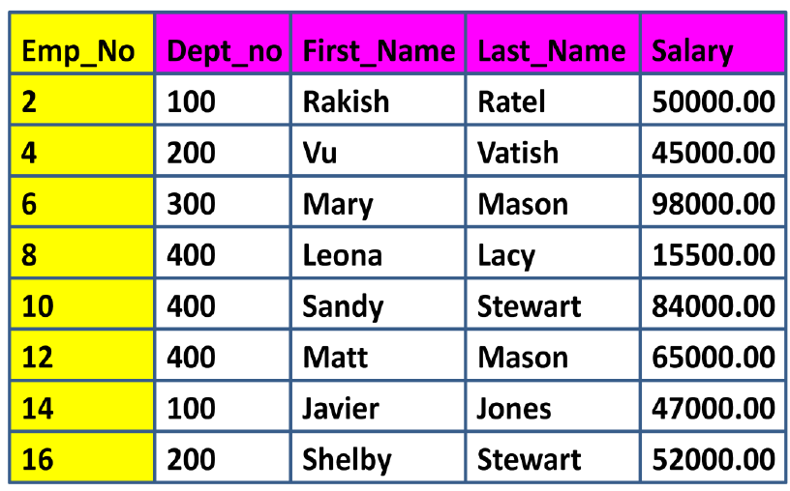
UPI OR NUPI

Slide 78
Unique Primary Index (UPI)
A Unique Primary Index (UPI) is unique and can’t have any duplicates
A Unique Primary Index means that the values for the selected column must be unique
If you try and insert a row with a Primary Index value that is already in the table,
the row will be rejected.
A Unique Primary Index will always spread the table rows evenly amongst the AMPs.

Slide 79
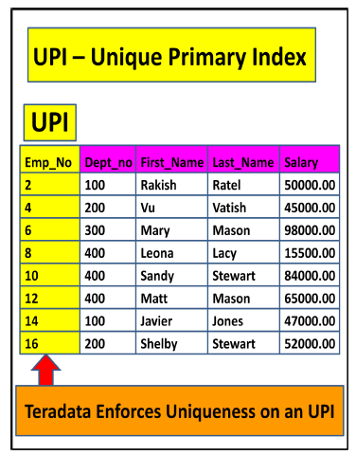

Slide 80
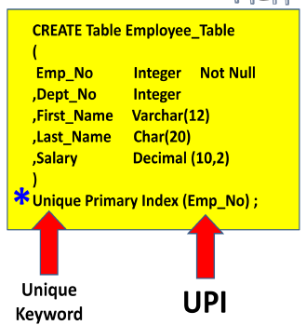

Slide 81
Non-Unique Primary Index (NUPI)
A Non-Unique Primary Index (NUPI) means that the values for the selected column can be non-unique
A Non-Unique Primary Index will almost never spread the table rows evenly
An All-AMP operation will take longer if the data is unevenly distributed
You might pick a NUPI over an UPI because the NUPI column may be more effective for query access and joins.

Slide 82
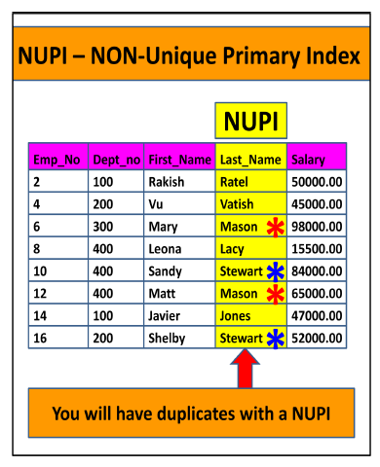

Slide 83
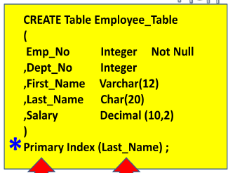

Slide 84
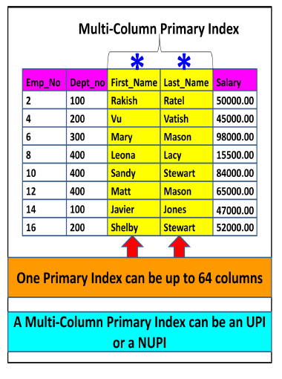
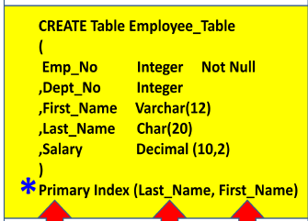
Multi-Column Primary Indexes
Teradata allows more than one column to be designated as the Primary Index.
Teradata allows up to 64 combined columns to make up the one Primary Index required for
a table.
This is often done for two reasons:
(1) To get better data distribution among the AMPs
(2) Users often use multiple keys consistently to query

Slide 85
Secondary Indexes
Secondary Indexes provide an alternate path to the data
Secondary Indexes are not as fast as the Primary Index, but they can be pretty fast, and they can be much faster than a Full Table Scan
Upto 32 secondary indexes per table
Every Secondary Index creates a Subtable on every AMP designed to point to the real Primary Index Row-ID.
two types of Secondary Index and they are
Unique Secondary Indexes, which are called USIs
Non-Unique Secondary Indexes called NUSIs.
USI is always a Two-AMP operation so it is almost as fast as a Primary Index, but a NUSI is an All-AMP operation, but not a Full Table Scan

Slide 86
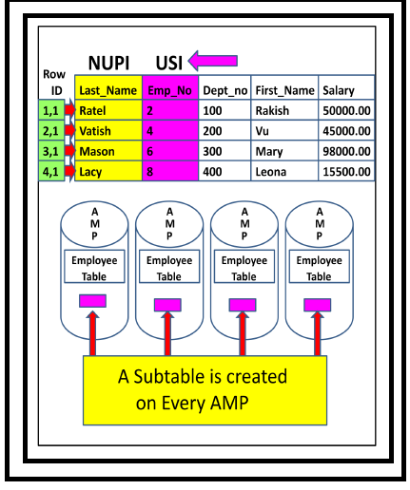
Create unique index on employees(empno)

Slide 87
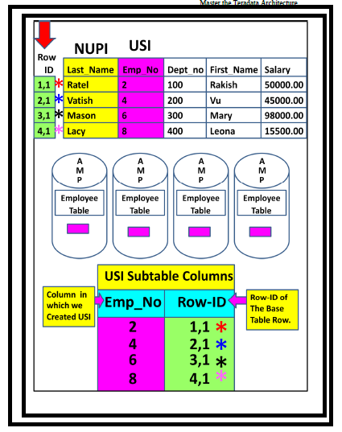

Slide 88
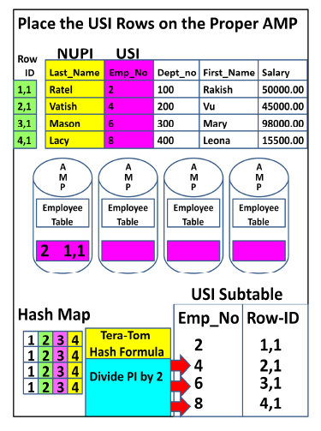

Slide 89
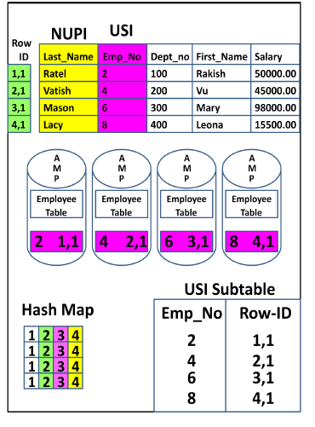

Slide 90
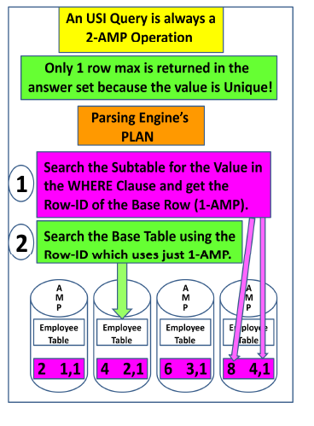

Slide 91
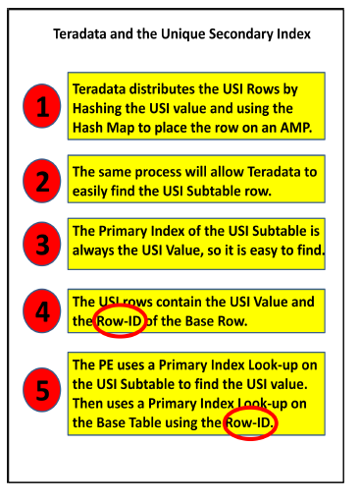

Slide 92
Teradata – Partitioned Primary Index
Partitioned Primary Index (PPI) is an indexing mechanism that is useful in improving the
performance of certain queries.
When rows are inserted into a table, they are stored in an AMP and arranged by their row id
When a table is defined with PPI, the rows are sorted by their partition number.
Advantages
Avoid full table scan for certain queries.
Avoid using secondary index that requires additional physical structure and
additional I/O maintenance.
Access a subset of a large table quickly.
Drop the old data quickly and add new data.

Slide 93
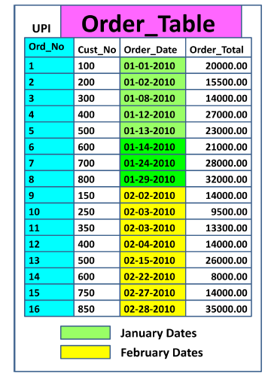

Slide 94
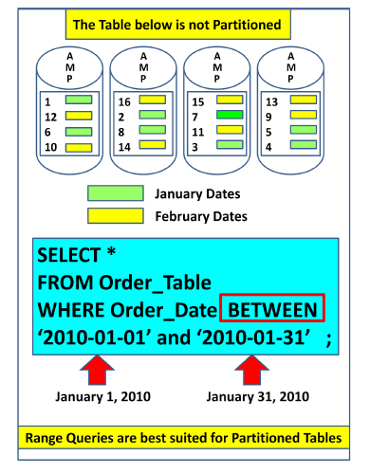

Slide 95
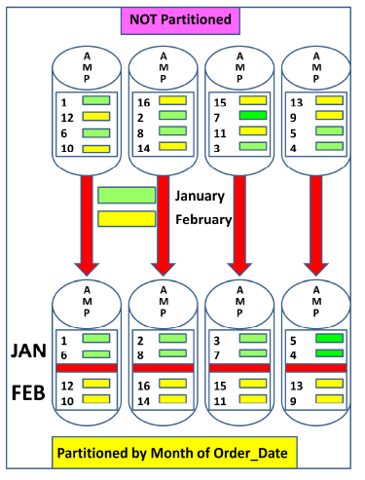

Slide 96
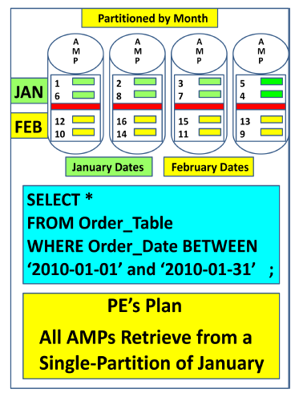

Slide 97
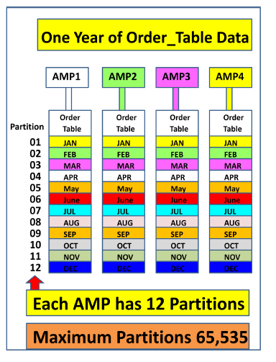

Slide 98
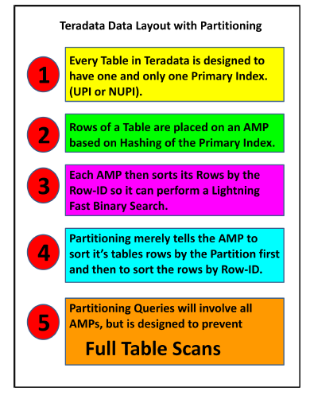

Slide 99
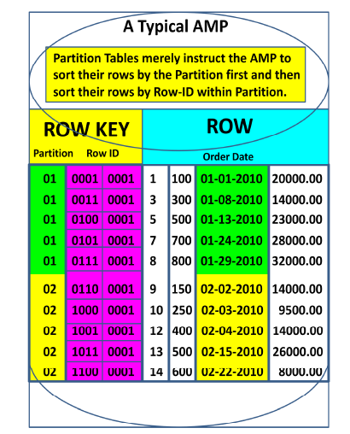

Slide 100
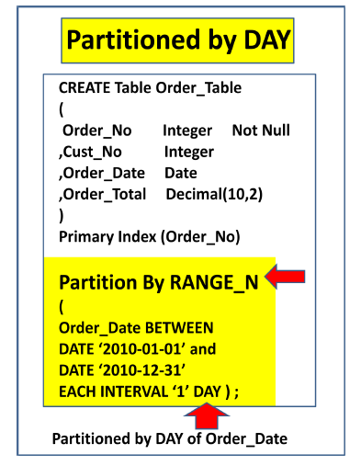

Slide 101
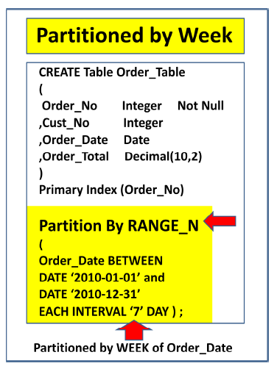

Slide 102
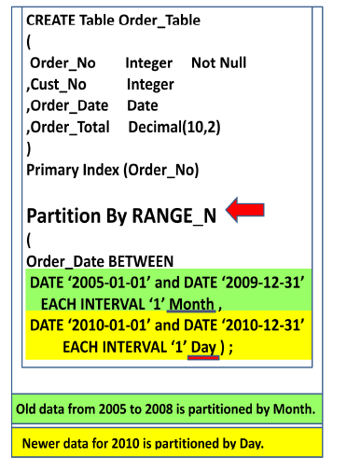

Slide 103
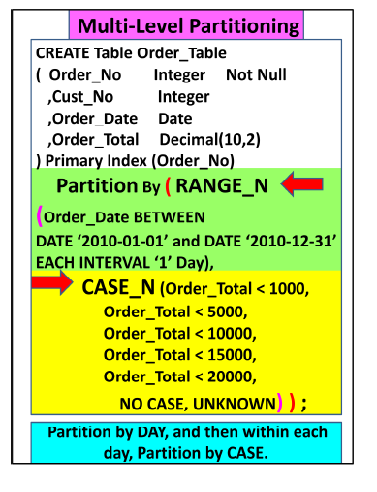

Slide 104
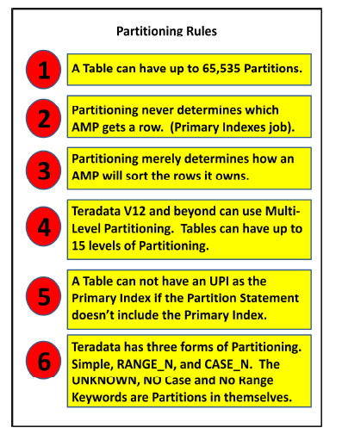

Slide 105
Teradata – JOIN INDEX
JOIN INDEX is a materialized view.
Its definition is permanently stored and the data is updated whenever the base tables referred in the join index is updated.
JOIN INDEX may contain one or more tables and also contain pre-aggregated data.
Join indexes are mainly used for improving the performance
Single Table Join Index (STJI)
Multi Table Join Index (MTJI)
Aggregated Join Index (AJI)

Slide 106
CREATE SET TABLE EMPLOYEE,FALLBACK
(
EmployeeNo INTEGER,
FirstName VARCHAR(30) ,
LastName VARCHAR(30) ,
DOB DATE FORMAT 'YYYY-MM-DD',
JoinedDate DATE FORMAT 'YYYY-MM-DD',
DepartmentNo BYTEINT
) UNIQUE PRIMARY INDEX ( EmployeeNo );
CREATE SET TABLE SALARY,FALLBACK
( EmployeeNo INTEGER,
Gross INTEGER,
Deduction INTEGER,
NetPay INTEGER )
PRIMARY INDEX ( EmployeeNo );

Slide 107
Multi Table Join Index (MTJI)
CREATE JOIN INDEX Employee_JI
AS
SELECT EmployeeNo,FirstName,LastName,
BirthDate,JoinedDate,DepartmentNo
FROM Employee
PRIMARY INDEX(FirstName);
If the user submits a query with a WHERE clause on EmployeeNo, then the system will query the Employee table using the unique primary index
If the user queries the employee
table using employee_name, then the system may access the join index Employee_JI using employee_name.
EXPLAIN SELECT * FROM EMPLOYEE WHERE FirstName='Mike';

Slide 108
CREATE JOIN INDEX Employee_Salary_JI
AS
SELECT a.EmployeeNo,a.FirstName,a.LastName,
a.BirthDate,a.JoinedDate,a.DepartmentNo,b.Gross,b.Deduction,b.NetPay FROM Employee a
INNER JOIN Salary b
ON(a.EmployeeNo=b.EmployeeNo)
PRIMARY INDEX(FirstName);
Whenever the base tables Employee or Salary are updated, then the Join index Employee_Salary_JI is also automatically updated
If you are running a query joining
Employee and Salary tables, then the optimizer may choose to access the data from Employee_Salary_JI directly instead of joining the tables.

Slide 109
Aggregate Join Index
CREATE JOIN INDEX Employee_Salary_JI
AS
SELECT a.DepartmentNo,SUM(b.NetPay) AS TotalPay
FROM Employee a INNER JOIN Salary b ON( a.EmployeeNo=b.EmployeeNo)
GROUP BY a.DepartmentNo Primary Index(DepartmentNo);

Slide 110
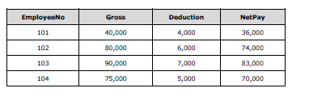
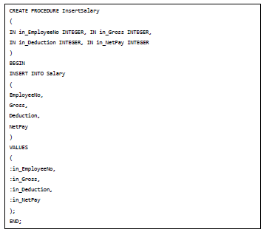
Teradata – Stored Procedure
CALL InsertSalary(105,20000,2000,18000);

Slide 111
Join Methods
Teradata uses different join methods to perform join operations. Some of the commonly
used Join methods are:
Merge Join
Nested Jon
Product Join
Merge Join
Merge Join method takes place when the join is based on the equality condition.
Merge Join requires the joining rows to be on the same AMP. Rows are joined based on their row hash.

Slide 112
Strategy #1
If the join columns are the primary indexes of the corresponding tables, then the joining
rows are already on the same AMP. In this case, no distribution is required.
Consider the following Employee and Salary Tables.
CREATE SET TABLE EMPLOYEE,FALLBACK
(
EmployeeNo INTEGER, FirstName VARCHAR(30) ,LastName VARCHAR(30) ,
DOB DATE FORMAT 'YYYY-MM-DD', JoinedDate DATE FORMAT 'YYYY-MM-DD',
DepartmentNo BYTEINT )UNIQUE PRIMARY INDEX ( EmployeeNo );
CREATE SET TABLE Salary
( EmployeeNo INTEGER, Gross INTEGER,Deduction INTEGER,
NetPay INTEGER )UNIQUE PRIMARY INDEX(EmployeeNo);
When these two tables are joined on EmployeeNo column, then no redistribution takes place since EmployeeNo is the primary index of both the tables which are being joined.

Slide 113
Strategy #2
Consider the following Employee and Department tables
CREATE SET TABLE EMPLOYEE,FALLBACK
(
EmployeeNo INTEGER, FirstName VARCHAR(30) ,
LastName VARCHAR(30) , DOB DATE FORMAT 'YYYY-MM-DD',
JoinedDate DATE FORMAT 'YYYY-MM-DD', DepartmentNo BYTEINT
) UNIQUE PRIMARY INDEX ( EmployeeNo );
CREATE SET TABLE DEPARTMENT,FALLBACK
(
DepartmentNo BYTEINT,
DepartmentName CHAR(15) )
UNIQUE PRIMARY INDEX ( DepartmentNo );
In this scenario, joining rows may not be on the same AMP. In such case,
Teradata may redistribute employee table on DepartmentNo column.

Slide 114
Nested Join
Nested Join doesn’t use all AMPs. For the Nested Join to take place, one of the condition should be equality on the unique primary index of one table and then joining this column to any index on the other table
Product Join
Product Join compares each qualifying row from one table with each qualifying row from other table. Product join may take place due to some of the following factors:
Where condition is missing.
Join condition is not based on equality condition.
Table aliases is not correct.
Multiple join conditions.

Slide 115
FastLoad utility
FastLoad utility is used to load data into empty tables. Since it does not use transient
journals, data can be loaded quickly. It doesn't load duplicate rows even if the target table
is a MULTISET table.
Phase 1
The Parsing engines read the records from the input file and sends a block to each AMP
Each AMP stores the blocks of records.
Then AMPs hash each record and redistribute them to the correct AMP.
At the end of Phase 1, each AMP has its rows but they are not in row hash sequence.
Phase 2
Phase 2 starts when FastLoad receives the END LOADING statement.
Each AMP sorts the records on row hash and writes them to the disk.
Locks on the target table is released and the error tables are dropped

Slide 116
Example
101,Mike,James,1980-01-05,2010-03-01,1
102,Robert,Williams,1983-03-05,2010-09-01,1
103,Peter,Paul,1983-04-01,2009-02-12,2
104,Alex,Stuart,1984-11-06,2014-01-01,2
105,Robert,James,1984-12-01,2015-03-09,3

Slide 117
LOGON 192.168.1.102/dbc,dbc;
DATABASE tduser;
BEGIN LOADING tduser.Employee_Stg
ERRORFILES Employee_ET, Employee_UV
CHECKPOINT 10;
SET RECORD VARTEXT ",";
DEFINE in_EmployeeNo (VARCHAR(10)) ,
in_FirstName (VARCHAR(30)) , in_LastName (VARCHAR(30)) ,
in_BirthDate (VARCHAR(10)) , in_JoinedDate (VARCHAR(10)) ,
in_DepartmentNo (VARCHAR(02)) , FILE=employee.txt;
INSERT INTO Employee_Stg
(EmployeeNo,FirstName,LastName,BirthDate,JoinedDate,
DepartmentNo) VALUES ( :in_EmployeeNo , :in_FirstName ,
:in_LastName , :in_BirthDate (FORMAT 'YYYY-MM-DD'),
:in_JoinedDate (FORMAT 'YYYY-MM-DD'), :in_DepartmentNo );
END LOADING;
LOGOFF;
FastLoad < EmployeeLoad.fl;

Slide 118
Teradata – MultiLoad
MultiLoad can load multiple tables at a time and it can also perform different types of tasks such as INSERT, DELETE, UPDATE and UPSERT. It can load up to 5 tables at a time and perform up to 20 DML operations in a script. The target table is not required for MultiLoad.
MultiLoad supports two modes:
IMPORT
DELETE
Log Table: Used to maintain the checkpoints taken during load which will be used for restart.
Error Tables: These tables are inserted during load when an error occurs. First
error table stores conversion errors whereas second error table stores duplicate
records.
Log Table: Maintains the results from each phase of MultiLoad for restart purpose.
Work table: MultiLoad script creates one work table per target table. Work table
is used to keep DML tasks and the input data.

Slide 119
Limitation
MultiLoad has some limitations.
Unique Secondary Index not supported on target table.
Referential integrity not supported.
Triggers not supported
How MultiLoad Works
MultiLoad import has five phases:
Phase 1: Preliminary Phase – Performs basic setup activities.
Phase 2: DML Transaction Phase –Verifies the syntax of DML statements and
brings them to Teradata system.
Phase 3: Acquisition Phase – Brings the input data into work tables and locks the table.
Phase 4: Application Phase – Applies all DML operations
Phase 5: Cleanup Phase – Releases the table lock.

Slide 120
.LOGTABLE tduser.Employee_log;
.LOGON 192.168.1.102/dbc,dbc;
.BEGIN MLOAD TABLES Employee_Stg;
.LAYOUT Employee;
.FIELD in_EmployeeNo * VARCHAR(10);
.FIELD in_FirstName * VARCHAR(30);
.FIELD in_LastName * VARCHAR(30);
.FIELD in_BirthDate * VARCHAR(10);
.FIELD in_JoinedDate * VARCHAR(10);
.FIELD in_DepartmentNo * VARCHAR(02);
.DML LABEL EmpLabel;
INSERT INTO Employee_Stg
(EmployeeNo,FirstName,LastName,BirthDate,JoinedDate,DepartmentNo)
VALUES (:in_EmployeeNo,:in_FirstName,:in_Lastname,
:in_BirthDate, :in_JoinedDate,:in_DepartmentNo);
.IMPORT INFILE employee.txt
FORMAT VARTEXT ','
LAYOUT Employee
APPLY EmpLabel;
. END MLOAD;
LOGOFF;
Multiload < EmployeeLoad.ml;

Slide 121
Teradata – FastExport
.LOGTABLE tduser.employee_log;
.LOGON 192.168.1.102/dbc,dbc;
DATABASE tduser;
.BEGIN EXPORT SESSIONS 2;
.EXPORT OUTFILE employeedata.txt
MODE RECORD FORMAT TEXT;
SELECT CAST(EmployeeNo AS CHAR(10)) ,
CAST(FirstName AS CHAR(15)) ,
CAST(LastName AS CHAR(15)) ,
CAST(BirthDate AS CHAR(10))
FROM
Employee;
.END EXPORT;
.LOGOFF;
fexp < employee.fx

Slide 122
BTEQ utility
BTEQ utility is a powerful utility in Teradata that can be used in both batch and interactive mode.
It can be used to run any DDL statement, DML statement, create Macros and stored
procedures.
BTEQ can be used to import data into Teradata tables from flat file and it can also be used to extract data from tables into files or reports

Slide 123
.LOGON 192.168.1.102/dbc,dbc;
DATABASE tduser;
CREATE TABLE employee_bkup
(
EmployeeNo INTEGER,
FirstName CHAR(30),
LastName CHAR(30),
DepartmentNo SMALLINT,
NetPay INTEGER
)
Unique Primary Index(EmployeeNo);
.IF ERRORCODE <> 0 THEN .EXIT ERRORCODE;
SELECT * FROM
Employee
Sample 1;
.IF ACTIVITYCOUNT <> 0 THEN .GOTO InsertEmployee;
DROP TABLE employee_bkup;
.IF ERRORCODE <> 0 THEN .EXIT ERRORCODE;

Slide 124
.LABEL InsertEmployee
INSERT INTO employee_bkup
SELECT a.EmployeeNo,
a.FirstName,
a.LastName,
a.DepartmentNo,
b.NetPay
FROM
Employee a INNER JOIN Salary b
ON (a.EmployeeNo=b.EmployeeNo);
.IF ERRORCODE <> 0 THEN .EXIT ERRORCODE;
.LOGOFF;

